Slide 1
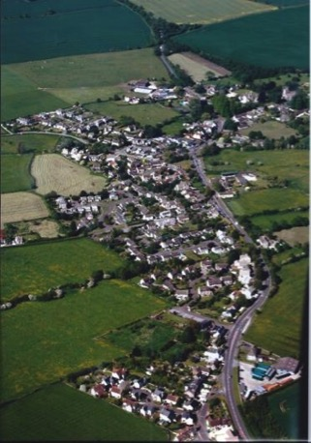
Reg 14, Public Consultation
8th December 2018 to
1st February 2019

Slide 2
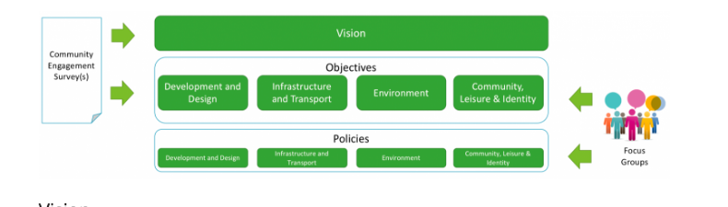
The Consultation Process
  The Approach Taken
  How the issues are dealt with by Core policies, NP Policies and future plans
  The Main Issues
Notes:
Sian tallks….20 mins for this section including the display visuals up to Housing

Slide 3
Flooding and Sewerage
Traffic/Pedestrian Safety
Broadband and Mobile Communications
The Environment
Community Facilities
Business support/development
Housing Allocation
Affordability of Housing
Housing Design

Slide 4
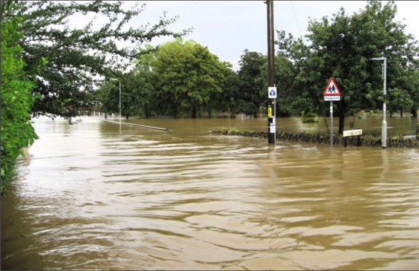
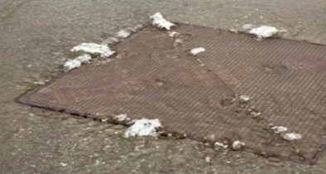
CONSIDERATIONS
NEIGHBOURHOOD
PLAN PROPOSAL
WHAT THE COMMUNITY HAD TO SAY
Deal with surface water drainage/flooding
Extra run-off from more housing areas with increased impermeable surfaces is a concern for flooding
Deal with sewerage back-up issues in heavy rain
Provide necessary infrastructure enhancements alongside any development
Better maintenance / clearing of rivers and culverts
NEIGHBOURHOOD PLAN POLICIES
IT1: Surface Water Drainage ensures that, when a site is developed, the rate of surface water run-off rate is lower, ideally by 20%, than the existing situation.
IT2: Foul Water Drainage - As Crudwell is sewered, policy IT2 ensures that any development connects to the existing sewer, and that Wessex Water can influence the rate that foul water enters the sewer to ensure that this will not make existing problems worse.
DD1, which allocates the Tuners Lane site for development, explicitly cross refers to policy IT1 to ensure that the development of this site will improve the current situation.
v
FLOODING AND SEWERAGE
EVIDENCE WE’VE GATHERED
Historical flooding – Wessex Water and parishioners experiences and photos
Environment Agency mapping of flood risk from rivers and surface water
Wiltshire Council – Drainage Engineering team
Wessex Water
NON-STATUTORY PROJECTS
The importance to the community of managing and maintaining the watercourses and drainage channels is noted. Villagers clear the Swillbrook each year on a voluntary basis and, whilst this helps the situation, it is insufficient and not a strategic solution. Whilst this is outside the powers of a NP, it has been addressed in the non-statutory projects section.
WILTSHIRE’S CORE POLICIES
67 – Flood risk, requires “all new development to include measures to reduce the rate of rainwater run-off and improve rainwater infiltration to soil and ground (sustainable urban drainage) unless site or environmental conditions make these measures unsuitable.”
3 - Infrastructure deals with sewerage and water supply pipes cables etc.
EXISTING COVER
In recent years, Wessex Water has looked to address the sewage overflow problem by reducing the amount of surface and groundwater entering the sewerage network.
2016, Wessex Water removed large amount of roof and paved area at the School from foul sewer network and constructed attenuation pond to reduce impact of run-off to Swill Brook.
Wessex Water currently carrying out CCTV surveys to identify any leaks in foul sewer network, to be sealed

Slide 5
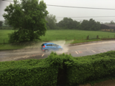
CONSIDERATIONS
NEIGHBOURHOOD
PLAN PROPOSAL
COMMUNITY VIEWS ABOUT IMPORTANCE OF IMPROVING ROAD AND PEDESTRIAN SAFETY IN THE PARISH
Address traffic capacity/volume issues
Better, more continuous pavements in identified areas
Control speed
Safe Crossing points across A429
Safe car parking for School / Church
Poor road conditions
NEIGHBOURHOOD PLAN POLICIES
DD1:Tuners Lane – This site meets the Parish’s identified housing need for 20-25 houses within Crudwell village, and when fully developed, is likely to generate 16 car journeys in the morning peak hour: 12 journeys from the site and four journeys to the site. This equates to one journey every four minutes.
DD1a:Tuners Lane – Provides for completion of footpath along Tuners Lane from the NP proposed site allocation to the A429.
DD2c&d: Windfall Housing – Provides safe vehicular access to the highway network; and safe pedestrian access to facilities within Crudwell village.
IT3: Highway Safety – Proposals for new development must demonstrate how pedestrians from the development will safely access the parish’s facilities, particularly the Primary School and Developer contributions will be sought for this.
v
TRAFFIC & PEDESTRIAN SAFETY
EVIDENCE WE’VE GATHERED
Traffic Surveys
Tuners Lane Traffic Report
Footpaths PHOTO
Housing needs assessment
WILTSHIRE’S CORE POLICIES
60 - Sustainable transport and location of development - reducing need to travel / length of journeys
61 - Focusses on the location and design of new development, and requires “that the proposal is capable of being served by safe access to the highway network”
62 - Development impact on transport network - making sure the impacts of development are mitigated
64 - Parking - planning capacity in new developments – notes that “traffic management measures will be developed to … lower the risk of accidents…”
NON-STATUTORY PROJECTS
Improved/more holistic approach to public transport – better connections for local commuters to help address increasing levels of road traffic.
EXISTING COVER
Concerns about traffic speeds and need for safe crossing points across the A429 were noted but outside the powers of the NP – however they are being/have been addressed by the School Safety Team.

Slide 6


CONSIDERATIONS
NEIGHBOURHOOD
PLAN PROPOSAL
COMMUNITY VIEWS ON ELECTRONIC COMMUNICATIONS
Continued improvement in broadband speeds and the provision of better mobile communications coverage is important to Parishioners, particularly in facilitating work from home and in encouraging local businesses.
Mobile communications are reasonable but there is poor reception in some areas of the Parish such as Eastcourt area.
NEIGHBOURHOOD PLAN POLICIES
IT4: Broadband – clarifies that the developers must deliver fibre-to-the-premises for any new dwellings or business premises in the parish.
IT5: Mobile Communications - Proposals which seek the improvement and expansion of the electronic communications network, high speed broadband and improved mobile/data coverage will be supported provided that the installation is the minimum required for efficient operation of the network and that there is no harm to the conservation area, listed buildings, the rural and village character, and neighbour’s amenity.
v
BROADBAND & MOBILE
EVIDENCE WE’VE GATHERED
Crudwell Parish broadband survey
Wiltshire Council – Online programme
Gigaclear
PAS 2016:2010 “Next generation access for new build homes – Government Guide”
EXISTING COVER
Gigaclear has been contracted by Wiltshire Council to deliver a new ultrafast fibre-to-premises broadband network to more than 5,500 properties in Wiltshire as part of the Wiltshire Online Programme. Work has already begun in Crudwell – This will provide homeowners with the opportunity to purchase fibre-to-the-premises.
WILTSHIRE’S CORE POLICIES
3 – Requires all new development “to provide for the necessary on-site and, where appropriate, off-site infrastructure requirements arising from the proposal”, with priority given to “essential infrastructure” which includes “telecommunications facilities, including fibre-optic superfast broadband connectivity services, to serve local communities and the business community”.

Slide 7
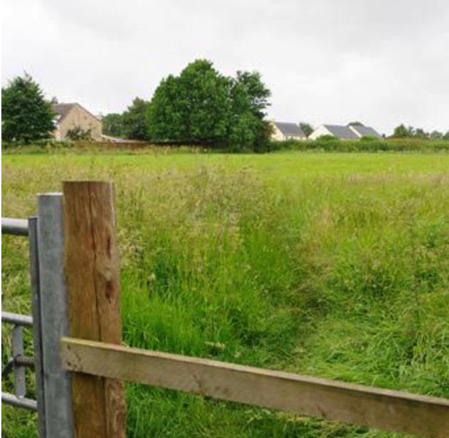
CONSIDERATIONS
NEIGHBOURHOOD PLAN PROPOSAL
COMMUNITY CONCERNS ON LOCAL ENVIRONMENT
It is important to Parishioners to preserve, protect and maintain:
  the local landscape and the conservation area
  wildlife and their habitats – water courses, hedgerows
  green spaces and recreational open spaces
There is a desire for more sustainable building design i.e. green build standards and renewable energy
Community wants to see new developments adopt sensitive green landscaping/ softening with sense of space
Crudwell’s setting and character is important to Parishioners
NEIGHBOURHOOD PLAN POLICIES
ENV1: Biodiversity – Development proposals should consider, assess and address their potential to protect, enhance, and provide additional wildlife habitats and corridors for roosting, nesting/shelter
DD1bandc: Tuners Lane – Development proposals must demonstrate that as much of the hedgerow fronting Tuners Lane is retained as is practicable, and where lost as a result of visibility splays, it must be re-provided immediately outside the splay. Proposals should provide a landscaped boundary to the site on it’s western and northern boundary.
ENV2: Renewable Energy - Supports renewable energy projects and energy efficiency measures on existing and new developments, provided they do not adversely impact on the character or appearance of the built environment within the parish.
DD3: Crudwell Design Code – Reflects views on Renewable Energy in ENV2 and DD1: Tuners Lane ensures compliance with DD3.
DD1: Tuners Lane – The plan recognises the importance to the community of protecting the Conservation area. Of the deliverable sites, the site proposed to be allocated in DD1 is furthest away from the conservation area and policy sets out several measures to minimise impact on views from conservation area
ENVIRONMENT
EVIDENCE WE’VE GATHERED
Heritage report – JME Conservation Ltd.
Focus Group – Community Environment Survey
WILTSHIRE’S CORE POLICIES
50 – Biodiversity and Geodiversity - requires development proposals to demonstrate how they would protect features of nature conservation and geological value by retaining, buffering and managing them, and then, where they cannot be retained, how impacts will be mitigated and compensated.
50 – Also requires development proposals to seek opportunities for biodiversity enhancement.
57 – Ensuring high quality design and place shaping
51 – landscape
52 – Green infrastructure
41 – Sustainable construction and low-carbon energy
42 – Standalone renewable energy installations
NON-STATUTORY PROJECTS
o Green Network Project – Considering each identified element, waterways and hedgerows for example, as part of a holistic green infrastructure network, and to consider how all the parts inter-link for the benefit of parishioners and wildlife. This will take some time, so these issues are proposed to be dealt with in the next draft of the Crudwell NP.
o Maintaining Drainage Channels - Villagers clear the Swill Brook each year on a voluntary basis and, whilst this helps the situation, it is insufficient and not a strategic solution. Could be put forward as a project to be funded out of the Community Infrastructure Levy (CIL) resulting from development in Crudwell.
o Important green spaces can be declared as Local Green Spaces (LGS), which provides additional protection from redevelopment. The next review of this NP can decide whether any buildings and LGS should have this additional protection.
EXISTING COVER
Village Green – protected by Wilts Core Policy 52 and owned by the PC, The Sports Field – protected by Wilts Core Policy 49 and owned by the PC, The Allotments and Post Office Green – protected by Wilts Core Policy 52
Crudwell’s character – Wilts Core Policy 57 requires all new developments to demonstrate how the proposal will make a positive impact to local character. However, to protect particular features, more evidence would be required and so SG recommends this is looked into further in the next NP. This is referred to in the non-statutory projects section.

Slide 8
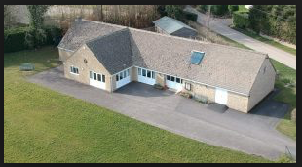
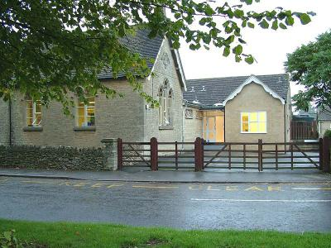
CONSIDERATIONS
NEIGHBOURHOOD
PLAN PROPOSAL
PARISHIONER VIEWS ON COMMUNITY FACILITIES
Strong Community desire to improve and protect existing community facilities, especially:
Crudwell CE Primary School site, ensuring long term sustainability
Village Green
Playing Fields on Village Hall Site
All Saints Church and Graveyard
The Village Hall
The Potting Shed Pub
The Allotments
Post Office Green – raised in the Environment surveys
Strong Community desire for a Village shop/Community Hub
NEIGHBOURHOOD PLAN POLICIES
DD1: Tuners Lane - developers will be required to fund suitable play improvements/ additional facilities on the site of the Village Hall, particularly for older children or teenagers, to be funded by Developer Open Space contributions
CL1: Crudwell Primary School Site – is safeguarded for educational use. Any proposals to redevelop any part of the school site for non-educational uses will be resisted.
DD3: Crudwell Design Guide (along with the Wilts Core policies, 57,58) would ensure design of any new educational development at the Primary School Site is in keeping with surroundings
COMMUNITY FACILITIES
EVIDENCE WE’VE GATHERED
Initial Community Engagement Survey
Community Focus Group – questionnaires relating to the idea of a “village shop/community hub” and assets of community value. Opinions were also sought on issues pertaining to Village School and the needs of local businesses
Conversations with Wiltshire Education and School Governors
NON-STATUTORY PROJECTS
Community Hub – NP Steering Group will work with the PC to look at this further. Subject to identification of site and business model, which ensures it’s long-term viability and does not impact unfavourably on other businesses or community assets within the parish. A centrally located community hub could also potentially provide additional parking for the school
WILTSHIRE’S CORE POLICIES
49 – Protection of existing rural services and community facilities
48 – Supporting Rural Life – focus on improving accessibility between towns and villages, social exclusion, isolation and rural deprivation, transport and infrastructure improvements.
3 – Infrastructure requirements – new development needs to support local schools – S106
4 – Helping to build resilient communities
40 – Protection for local businesses – e.g. Hotels, B&Bs and guest houses
CONSIDERATIONS FOR NEXT REVIEW OF NP
The community can decide whether any buildings and local green spaces should have additional protection:
Community facilities that are particularly important can be declared as “Assets of Community Value” This means that, if sold, the community has the opportunity to purchase and keep it in community use.
Important green spaces can be declared as Local Green Spaces, which provides additional protection from redevelopment
EXISTING COVER
Village Green is already protected by Wilts Core Policy 52 and owned by the PC
Playing Fields on Village Hall site already protected by Wilts Core Policy 49 and owned by the PC
Potting Shed Pub is a listed building and protected by Wilts Core Policy49
The Allotments and Post Office Green are protected by Wilts Core Policy 52
Crudwell CE Primary School site (including playing fields) is in Conservation area and so the design of any new educational development would be controlled by Wilts Core Policies 57 and 58

Slide 9
CONSIDERATIONS
NEIGHBOURHOOD
PLAN PROPOSAL
VIEWS OF COMMUNITY AND LOCAL BUSINESSES
Local economy is considered important, including protecting & expanding Kemble Business Park, supporting local businesses and those working from home.
Key issues for local businesses:
Affordability of land/premises to rent due to rising costs as landowners sell. Fear of survival.
Source of suitable employees, especially locals, who can afford to live and travel locally – concern over cost of property
Need for better information exchange; a local hub/forum for information
Poor general understanding of needs of small rural businesses with some incoming residents who resent “mess, noise and smells” in their rural idyl
NEIGHBOURHOOD PLAN POLICIES
IT4: Broadband – clarifies that the developers must deliver fibre-to-the-premises for any new dwellings or business premises in the parish.
IT5: Mobile Communications - Proposals which seek the improvement and expansion of the electronic communications network. Together with IT4, this supports local businesses and home workers
DD1: Tuners Lane and DD2f: Windfall Housing address the affordability issues for local people as potential employees
DD2: Windfall Housing supports individuals wishing to offer holiday accommodation, should there be an identified need
v
BUSINESS SUPPORT & DEVELOPMENT
Non-Statutory Projects
Community Hub – NP Steering Group will work with the PC to look at this further. Subject to identification of site and business model, which ensures it’s long-term viability and does not impact unfavourably on other businesses or community assets within the parish. Could include WiFi access, meeting space, shop, café, rentable general purpose space.
Kemble Airfield – Residential development at Kemble Airfield would not accord with the Wilts Core Strategy (WCS) BUT the WCS doesn’t currently include the Kemble Business Park amongst its designated “Principal Employment Areas”. This project would investigate with Wilts Council why that is and consider if the next draft of the Crudwell NP should protect the Kemble Business Park better
Public Transport – Could investigate improvements to the local bus service to provide better connections with Kemble rail station and nearby towns – to reduce commuter traffic and improve mobility of local employees
EVIDENCE WE’VE GATHERED
Initial engagement survey
Housing Needs Assessment
Community Focus Group – questionnaires relating to the idea of a “village shop/community hub.
Interviews with local businesses to understand needs
Wiltshire Council – Online programme
Gigaclear
WILTSHIRE’S CORE POLICIES
3 – Requires all new development “to provide for the necessary on-site and, where appropriate, off-site infrastructure requirements arising from the proposal”, with priority given to “essential infrastructure” which includes “telecommunications facilities, including fibre-optic superfast broadband connectivity services, to serve local communities and the business community”.
4 – Helping to build resilient communities
40 – Protection for local businesses – e.g. Hotels, B&Bs and guest houses
Existing cover
Gigaclear has been contracted by Wiltshire Council to deliver a new ultrafast fibre-to-premises broadband network to more than 5,500 properties in Wiltshire as part of the Wiltshire Online Programme. Work has already begun in Crudwell – This will provide homeowners with the opportunity to purchase fibre-to-the-premises.

Slide 10
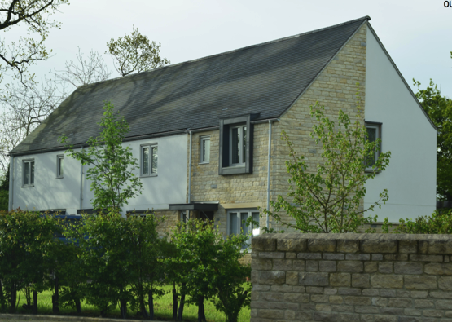
CONSIDERATIONS
NEIGHBOURHOOD
PLAN PROPOSAL
COMMUNITY COMMENTS ON NEED FOR MORE AFFORDABLE HOMES FOR LOCAL COMMUNITY
The need for more starter homes for the young and downsizing homes for the elderly/younger retirees is a significant concern for the community. NP notes that this is a different sort of affordability requirement to that defined in Wiltshire Council’s Core policy 43.
NEIGHBOURHOOD PLAN POLICIES
DD1e: Tuners Lane – meeting local housing needs by determining the type and size of the open market homes portion of any new development. i.e. policy seeks to deliver a greater proportion of affordable homes that are simply smaller and lower cost in some way but do not necessarily meet Wilts councils technical definition of affordable (defined in Core policy 43).
DD1: Tuners Lane – Policy meets the requirement for 8 affordable homes (as defined in Core policy 43) by allocating a site of 1.3 hectares, suitable for a residential development of 20-25 dwellings.
DD2f: Windfall Housing – In addition to DD1, applications for residential dwellings on Windfall sites within the Crudwell village Settlement Boundary will be supported where they meet six criteria (DD2), one of which is that it:
  Demonstrably meets an identified need for homes in Crudwell, for example: affordable housing, housing for the elderly, self-build housing and holiday accommodation.
v
Affordability
EVIDENCE WE’VE GATHERED
Crudwell Parish Housing needs assessment – Vision Planning, March 2018
Parish needs survey, 2015
Wiltshire Council’s affordability register
WILTSHIRE’S CORE POLICIES
43 - Need to provide 40% affordable as defined by Government. ie. affordable rent, starter homes, discounted market sale housing.
45 - Type mix and size of home – New housing, both market housing and affordable, must be well designed to address local housing need incorporating a range of different types, tenures and sizes of homes to create mixed and balanced communities.
Notes:
Roy will pick up here

Slide 11
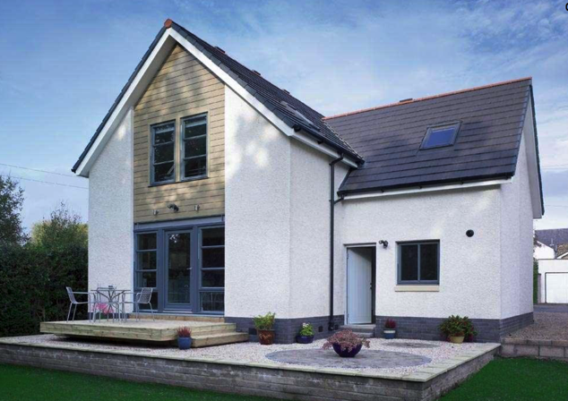
CONSIDERATIONS
NEIGHBOURHOOD
PLAN PROPOSAL
COMMUNITY VIEWS ON DESIGN
New development must be well located, of an appropriate scale and of a design which is sympathetic to it’s surroundings and in keeping with the character and appearance of Crudwell.
Importance of retaining Cotswold style in high quality design
A desire for more sustainable building design i.e. green build standards and renewable energy and inclusion of features such as electric car charging points
Sensitive green landscaping/ softening with sense of space
NEIGHBOURHOOD PLAN POLICIES AND THE CRUDWELL DESIGN CODE
Crudwell Design Code - All new developments in Crudwell Parish must “fit in”, in terms of their layout and design of the homes themselves. The Crudwell Design Code at Appendix 1 of the NP describes the distinctive characteristics of local architectural styles, and provides a benchmark against which new development proposals will be judged.
DD3: Design – Ensures development proposals are of a design quality that respects the character and distinctive appearance of Crudwell Parish by requiring them to meet the Crudwell Design Code.
DD1b,c and g: Tuners Lane – Ensures retention/replacement of hedgerows, provision on landscaped boundary and requires compliance with the Crudwell Design Code (Policy DD3)
DD2a and b: Windfall Housing – In addition to DD1, applications for residential dwellings on Windfall sites within the Crudwell village Settlement Boundary will be supported where they meet six criteria (DD2), two of which are that it:
  Reflects the character and scale of surrounding properties and of the village of Crudwell in terms of scale, form and layout; and
  Is of a high design quality in accordance with policy DD3
ENV2: Renewable Energy – Proposals for renewable and low carbon energy generation will be supported provided they have an acceptable visual impact on the immediate locality and the wider area, acceptable effect on living conditions of nearby residents, or that any harmful impact can be satisfactorily mitigated.
v
DESIGN
EVIDENCE WE’VE GATHERED
Design survey – as part of Neighbourhood Plan Development and Design focus group work
WILTSHIRE’S CORE POLICIES
57 – Ensuring high quality design and place shaping – drawing on local context and being complementary to the locality.
58 – Ensuring the conservation of the historic environment, including the special character or appearance of conservation areas
41 – Sustainable construction and low-carbon energy, encourages new development to incorporate design measures to reduce energy demand.

Slide 12
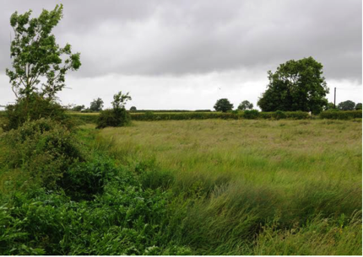
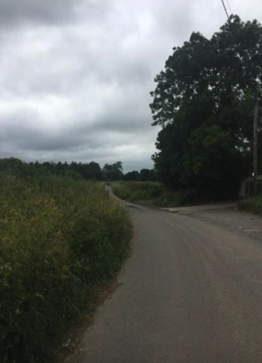
CONSIDERATIONS
NEIGHBOURHOOD
PLAN PROPOSAL
COMMUNITY CONSULTATION / THEMES AND REASONS FOR PARTICULAR SITE’S PREFERENCES
The size of development - smaller being preferred rather than larger.
The locations of the developments in relation to existing flood zones.
The potential impact of increased traffic on A429 and Tetbury Lane.
Retention of the character of the village.
v
EVIDENCE WE’VE GATHERED
Crudwell Parish Housing needs assessment – Vision Planning, March 2018
Heritage assessment
Traffic Surveys
Tuners Lane Traffic Report
Footpaths PHOTO
Historical flooding – Wessex Water and parishioners experiences and photos PHOTOS
Environment Agency mapping of flood risk from rivers and surface water
Wiltshire Council – Drainage Engineering team
Wessex Water
Parish needs survey, 2015
Wiltshire Council’s affordability register
Design survey – as part of Neighbourhood Plan Development and Design focus group work
SITE ALLOCATION
WILTSHIRE’S CORE POLICIES
2 – Housing numbers – 42,000 houses need to be built across Wiltshire to 2026
60 - Sustainable transport and location of development - reducing need to travel / length of journeys
61 - Focusses on the location and design of new development, and requires “that the proposal is capable of being served by safe access to the highway network”
62 - Development impact on transport network - making sure the impacts of development are mitigated
64 - Parking - planning capacity in new developments – notes that “traffic management measures will be developed to … lower the risk of accidents…”
67 – Flood risk, requires “all new development to include measures to reduce the rate of rainwater run-off and improve rainwater infiltration to soil and ground (sustainable urban drainage) unless site or environmental conditions make these measures unsuitable.”
3 - Infrastructure deals with sewerage and water supply pipes cables etc.
43 - Need to provide 40% affordable as defined by Government. ie. affordable rent, starter homes, discounted market sale housing.
45 - Type mix and size of home – New housing, both market housing and affordable, must be well designed to address local housing need incorporating a range of different types, tenures and sizes of homes to create mixed and balanced communities.
57 – Ensuring high quality design and place shaping – drawing on local context and being complementary to the locality.
58 – Ensuring the conservation of the historic environment, including the special character or appearance of conservation areas
41 – Sustainable construction and low-carbon energy, encourages new development to incorporate design measures to reduce energy demand

Slide 13
NEIGHBOURHOOD PLAN PROPOSAL
Site Allocation
ID | Name | Area (Ha) | Density (Ho/Ha) | Likely Dwellings | Community Ranking | Reason for rejecting
J | Tuners Lane | 1.30 | 20 | 26 | 1 | Full site assessment carried out against criteria set by Wiltshire Council
C | Ravenscourt | 0.40 | 20 | 8 | 1 | Rejected before full site assessment as Insufficient dwellings to meet the needs of the HNA and access unlikely without site B
E | Glebe Lands | 2.05 | 20 | 40 | 2 | Rejected before full site assessment as Not deliverable within the specified period to 2026
A | Carpenters Yard | 0.48 | 20 | 10 | 2 | Rejected before full site assessment as not deliverable within the specified period to 2026
D | Wyke House | 0.65 | 20 | 13 | 3 | Rejected before full site assessment as no access available
H | Rommel Lane | 0.40 | 20 | 8 | 3 | Rejected before full site assessment as insufficient dwellings to meet the needs of the NP Housing Needs Assessment
B | The Coach House | 0.98 | 20 | 19 | 3 | Rejected before full site assessment as not available within the specified period to 2026
F | Ridgeway Phase 2 | 1.85 | 20 | 37 | 4 | Full site assessment carried out against criteria set by Wiltshire Council
G | Ridgeway Phase 3 |  |  |  | 4 | Rejected before full site assessment as no access without Ridgeway Phase 2
K | The Old Dairy | 0.30 | 20 | 4 |  | Rejected before full site assessment as less than 5 houses, therefore classed as windfall
L | *Eastcourt ;(Late entry) | 0.40 | 20 | 8 |  | Rejected before full site assessment as it does not meet the requirements of the Core Strategy; Crudwell as a Large Village
RESULTING ALLOCATION AT TUNERS LANE
How does an allocation of 20-25 at Tuners Lane address community concerns?
DD1:Tuners Lane – This site meets the Parish’s identified housing need for 20-25 houses within Crudwell village and meets Core policy 43 requirement for 8 (40%) affordable homes as Wiltshire Council’s affordable housing register.
S106
When developed, Tuners Lane is likely to generate 16 car journeys in the morning peak hour: 12 journeys from the site and four journeys to the site. This equates to one journey every four minutes. Traffic levels on Tuners Lane are 1/3 of those on Tetbury lane. – Impact on pedestrian safety / safe school journeys
DD1a:Tuners Lane – Provides for completion of footpath along Tuners Lane from the NP proposed site allocation to the A429. The footpath on Tuners Lane is more complete than on Tetbury Lane and would not involve destruction of hedgerows to complete.
Tuners Lane site is further away from the Conservation area than Ridgeway Farm site and proposed 20-26 houses would sit at the front of the site in the dip, meaning they would sit against a backdrop of rising ground. On the contrary, Ridgeway Farm phases 1 and the proposed phase 2, sit on a ridge and phase 2 will be built on rising ground, so will be more prominent against the skyline.

Slide 14
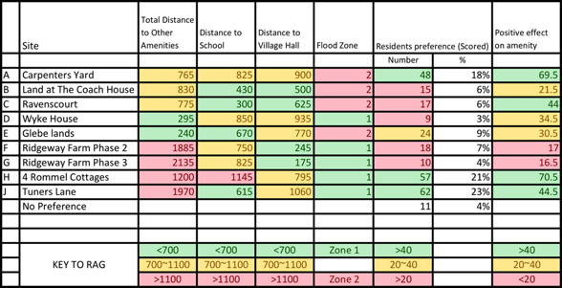
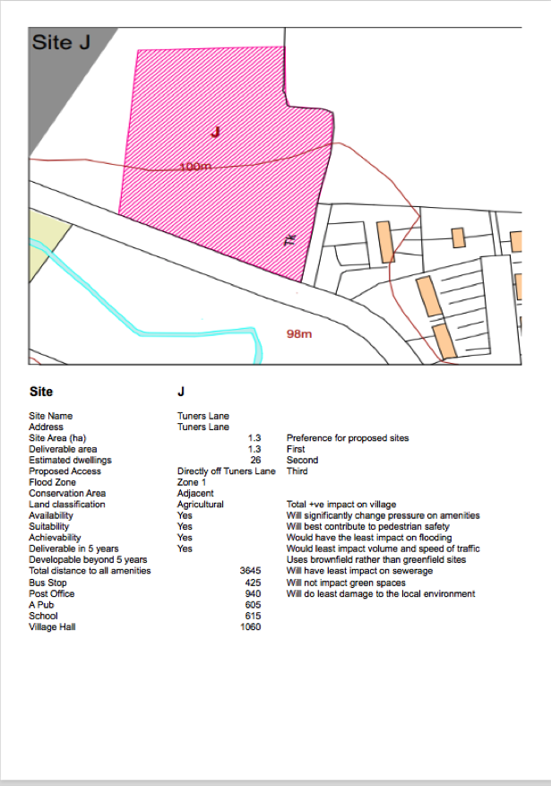

Slide 15
NEIGHBOURHOOD PLAN PROPOSAL
Site Allocation

