Slide 1
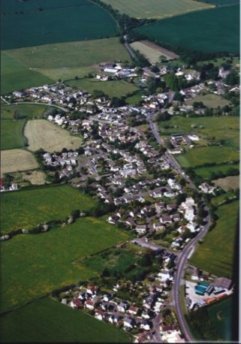
Crudwell Parish Council Neighbourhood Plan Update
Annual Parish Meeting
10th August 2019

Slide 2
Today’s Agenda
Setting the scene Pete Gilchreist
A brief history Mike
The Steering Group members Mike
The Ridgeway Farm appeals impact Mike
What we have found out from you in
the Reg 14 consultation and feedback Roy
Where we are now, decisions to be taken Roy
Our forward plan to Reg 16 and next steps Roy
Keeping you informed Mike
Any questions for the SG?. Mike
The Crudwell Community Hub Study Roy/Mike
Notes:
Pete to talk generally about the NP, Steering Group and PC support

Slide 3
A Brief History
The previous Neighbourhood Plan
On having no plan; the WC Ridgeway Farm Housing Site Allocation issue
Neighbourhood Plan start-up
Community Engagement
The Focus Groups, consultation and reports
The Reg 14 Consultation
The Ridgeway Farm planning appeals
Notes:
Sian or Mike to tell the tale, RL NEED DATES FOR ALL EVENTS

Slide 4
Your Steering Group Members
Sian Burke-Murphy - Chair
Mike Credicott - Parish Council Rep
Tristan Stevens - Vice Chair
Clare Buxton - Treasurer
Roy Lambley - Secretary/PC
Mike Smith
Jenny Salter
Helena Evanson-Goddard
Stuart Miles (Consultant) - Vision Planning

Slide 5
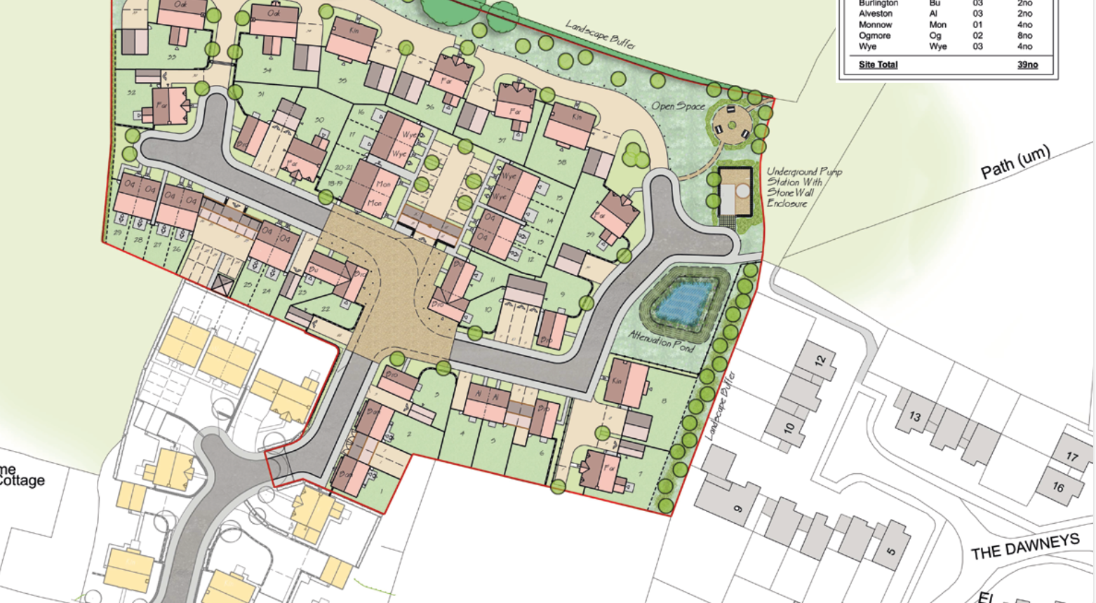
The Ridgeway Farm HSA Appeal
The HSA Inspector:
Needed to consider whether to allocate Ridgeway Farm (this would mean applications for housing on the site would no longer conflict with the development plan)
He concluded that there was “no strategic imperative to identify sites on this location and that local needs can be met through an emerging Neighbourhood Plan”
This means the site remains outside the development plan, it does not mean that no sites are needed to meet local needs.

Slide 6
The Ridgeway Farm Planning Appeal
Appeal against WC Planning refesal for an additional 36 dwellings
Refusal by the Planning Inspector on the grounds that:
He knew that the site was outside defined limits of development in adopted development plan
Had to consider whether any other material considerations outweighed conflict with development plan, e.g. a housing shortage.
He concluded that:
there was no strategic housing shortage that would override conflict with the development plan; that the development would harm the character and appearance of the area and dismissed the appeal.

Slide 7
The Appeals decisions mean;
That the work on the Neighbourhood plan has been recognised as advanced enough to deliver Crudwell’s housing needs to 2026.
That the Neighbourhood Plan can now re-commence its work.
If we fail to have the plan “made” there are risks of more developers’ planning applications succeeding in the future, these will be mitigated by the NP

Slide 8
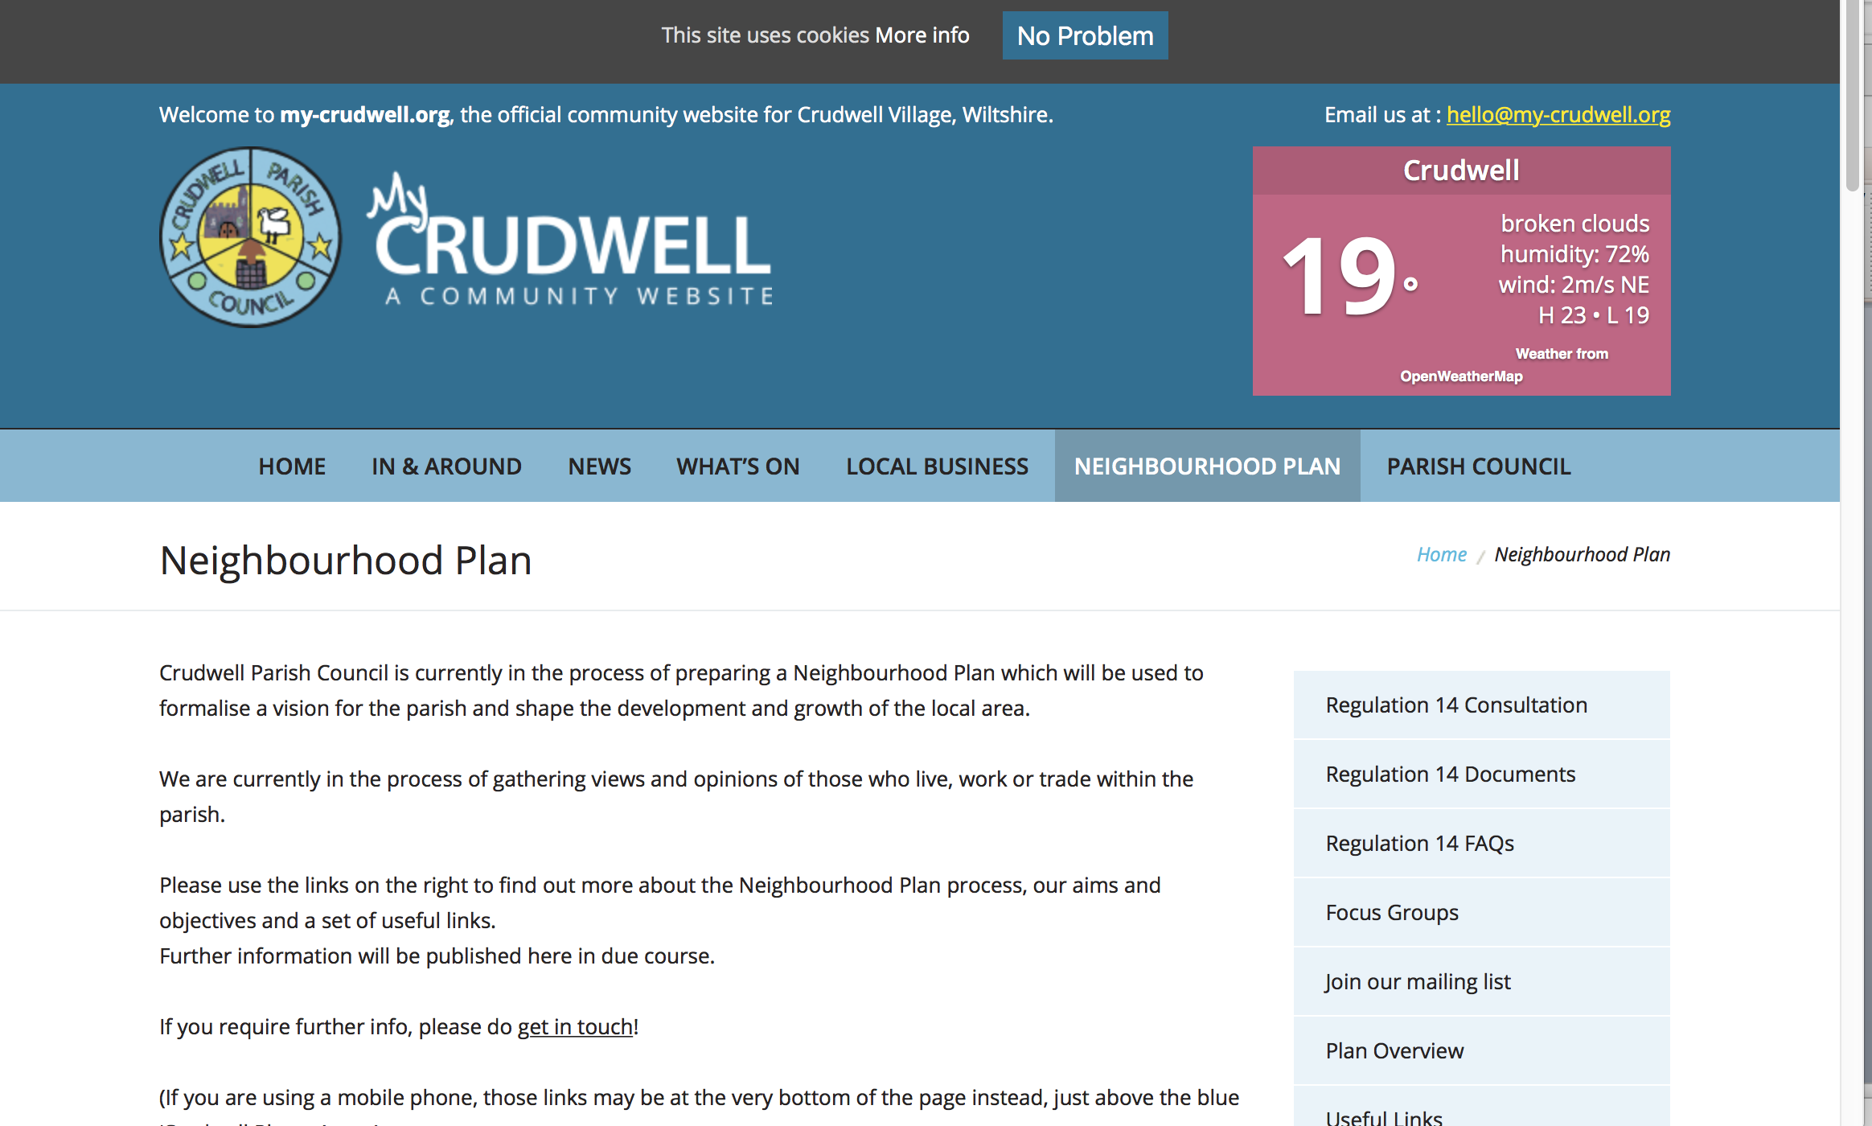
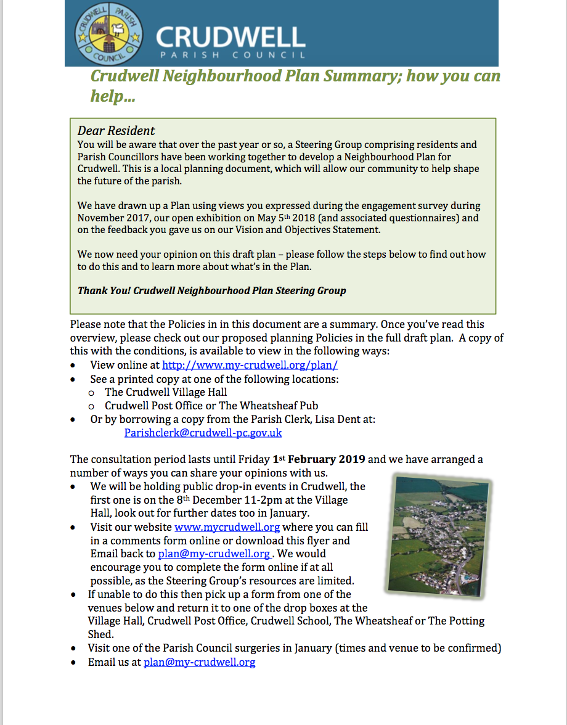
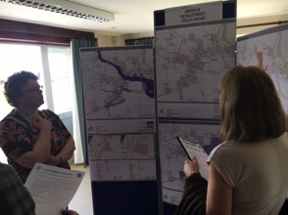
The Reg 14 Consultation
The Draft Neighbourhood Plan
Consultation Activity
8th November~ 1st February:-
My Crudwell Web Site
3 Events over 100 attended
WOIC
52 Mailing List updates
NP Summary and Feedback Form

Slide 9
The Reg 14 Consultation polices:
Three Housing Policies,
DD1 Site Allocation; Tuners Lane (the most sustainable available and deliverable achievable site)
DD2 Windfall Housing Policy
DD3 Design Policy
Eight other Policies covering
Flood Risk, Drainage and Flooding, Highway Safety, Communications, The Primary School and the Environment

Slide 10
The Reg 14 Feedback; Community
68 residents from the Crudwell community submitted representations.
75% Supported Policy DD1; Tuners Lane, 25% were opposed
98% supported all other policies
21 Residents made comments and suggestions

Slide 11
The Reg 14 Comments – Stakeholders (Statutory Bodies, developers)
64 representations were received from 4 Stakeholders including;
Wiltshire Council; 38 Comments, no objections
Developers; 26 Objections (19 from The Ridge)
These developers representations were across the board, only 4 directly referenced Policy DD1

Slide 12
Where we are now
We are now starting to prepare our next major stage; Preparation for Reg 16, This will mean:
Taking full account of and responding to all representations
Determining policy on 2026 or 2036 plan
A full review of all our policies and documentation
Ensuring that our housing site allocation/s are deliverable by 2026, this work will include;
An independent traffic survey
Further discussions with developers and landowners

Slide 13
Our Policy on 2026 vs. 2036 Neighbourhood Plan
The advantages of continuing the plan to complete the 2026 Neighbourhood Plan 2026 are as follows:
It is the current NP end date so needs no new evidence
It is the same as the Core Strategy
It means we can get NP made quickly
When NP is made, Crudwell will be safe from housing applications even with only 3 years Housing Land Supply in North and West Wiltshire Housing Market Area.
Our current advice is to continue to complete the 2026 Neighbourhood Plan

Slide 14
Our next steps; we will:
Determine approach to 2026 vs. 2036 Plan
Re-examine all representations and:
Ensure housing site/s are achievable, deliverable and sustainable by technical surveys (traffic, drainage etc.)
Re-examine housing needs/ number of sites allocated
Continue consultation with you
Recommend changes to the policies or maintain as is
Formally respond to all who made representations
Redraft the Neighbourhood Plan document set to produce Reg 16 version for submission to WC.

Slide 15
Where we are now
And What’s Next:
Steering Group work plan - Now and ongoing
More Consultations and Events - Autumn/Winter
Reg 16 (submission to WC) & Public Consultation - Autumn/Winter 2019
Examination (By a Planning Inspector) - Winter 2019
Referendum for Parishioners - Spring/Summer 2020

Slide 16
Keeping you informed:
Our Mailing List at: plan@my-crudwell.org
Our Website: http://www.my-crudwell.org/plan/
Village Exhibitions and meetings
Finally; Any other Questions
???

Slide 17
A Community Hub for Crudwell?
Requirements for a shop/café and business/meeting facilities expressed in the NP Consultation
The PC authorised a Feasibility Study to look at the need for a Community Hub
The study has commenced and the following work has been done….

Slide 18
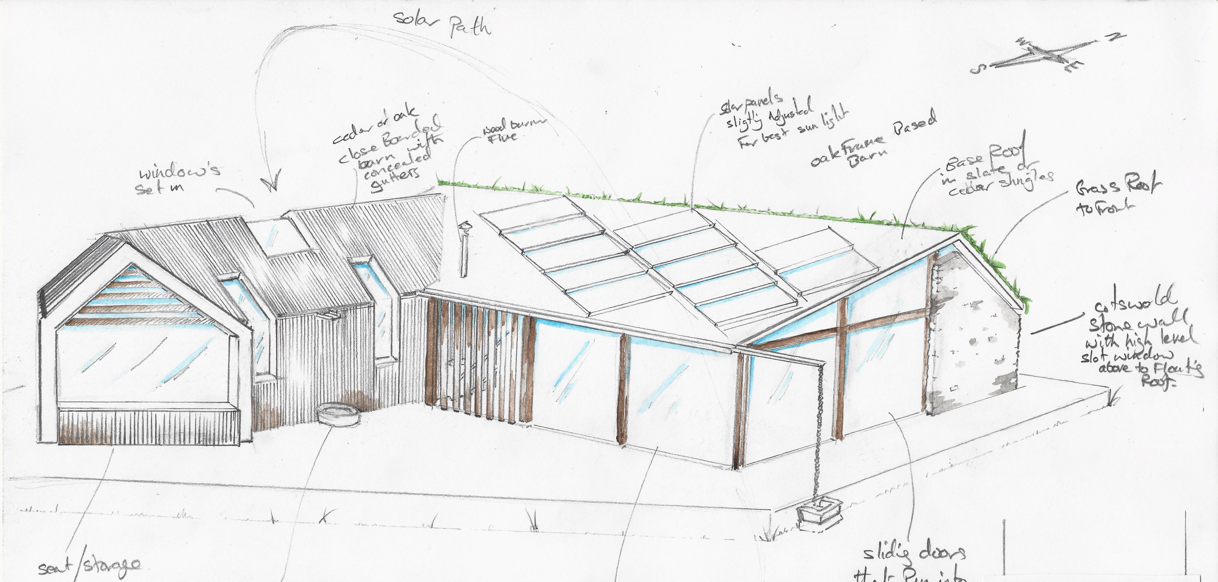
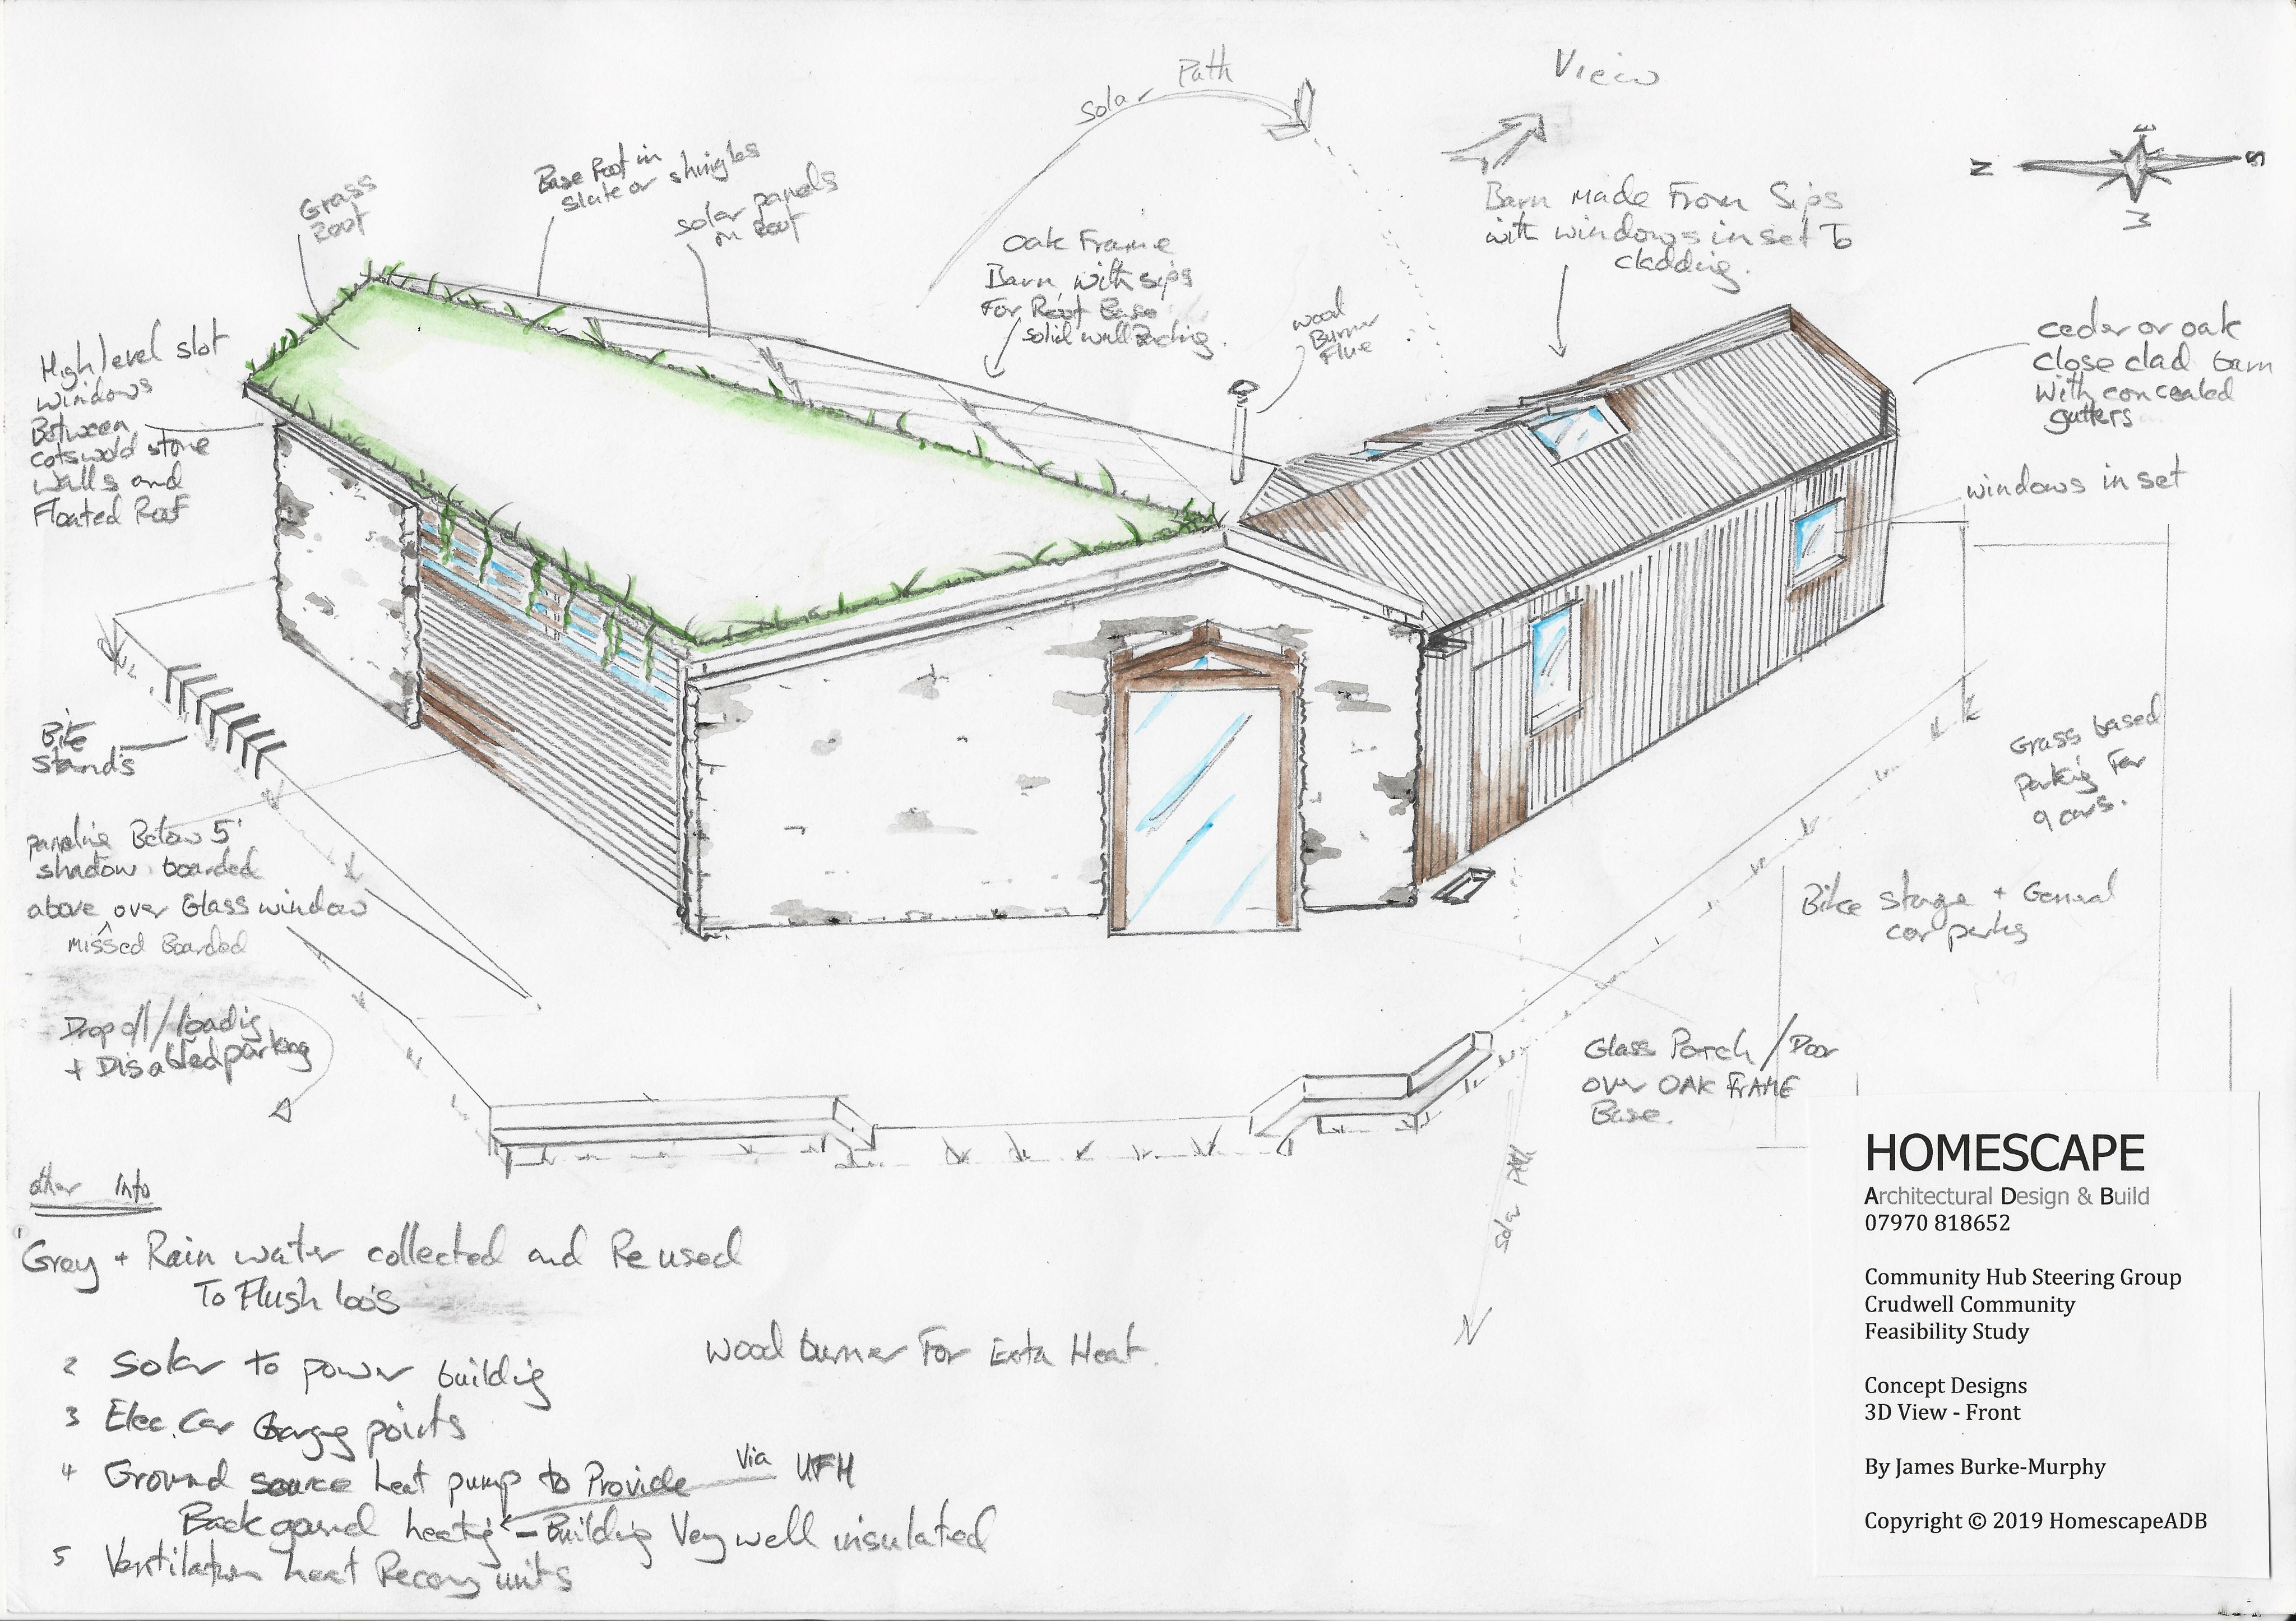
Community Hub Study Progress
Steering Group formed
Terms of reference agreed
Outline Spatial and artists designs prepared
Business Case in progress
Engagement with other Hubs, Horsley, Ide Hill, Hawkesbury Upton
Discussions with possible site owners
Engagement with The Plunket Foundation

Slide 19
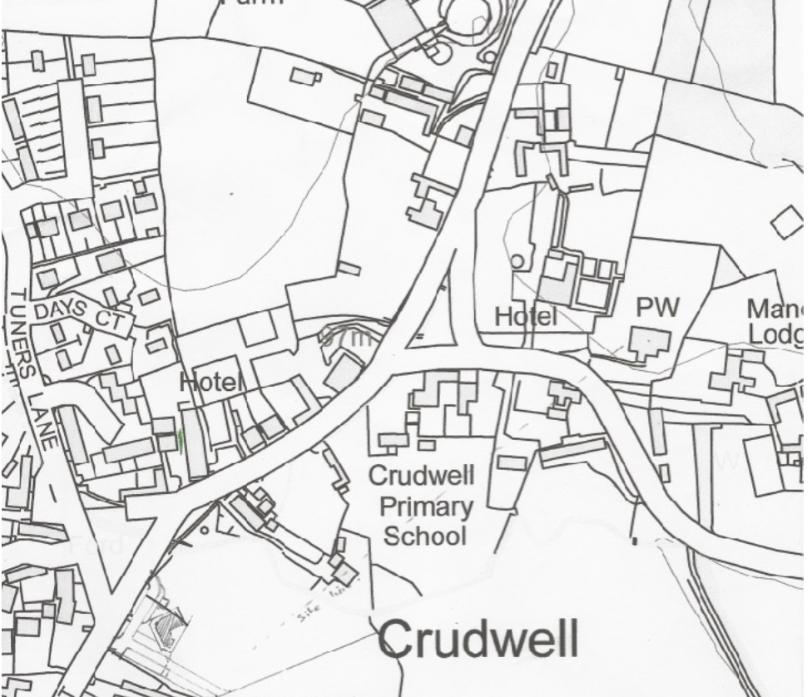
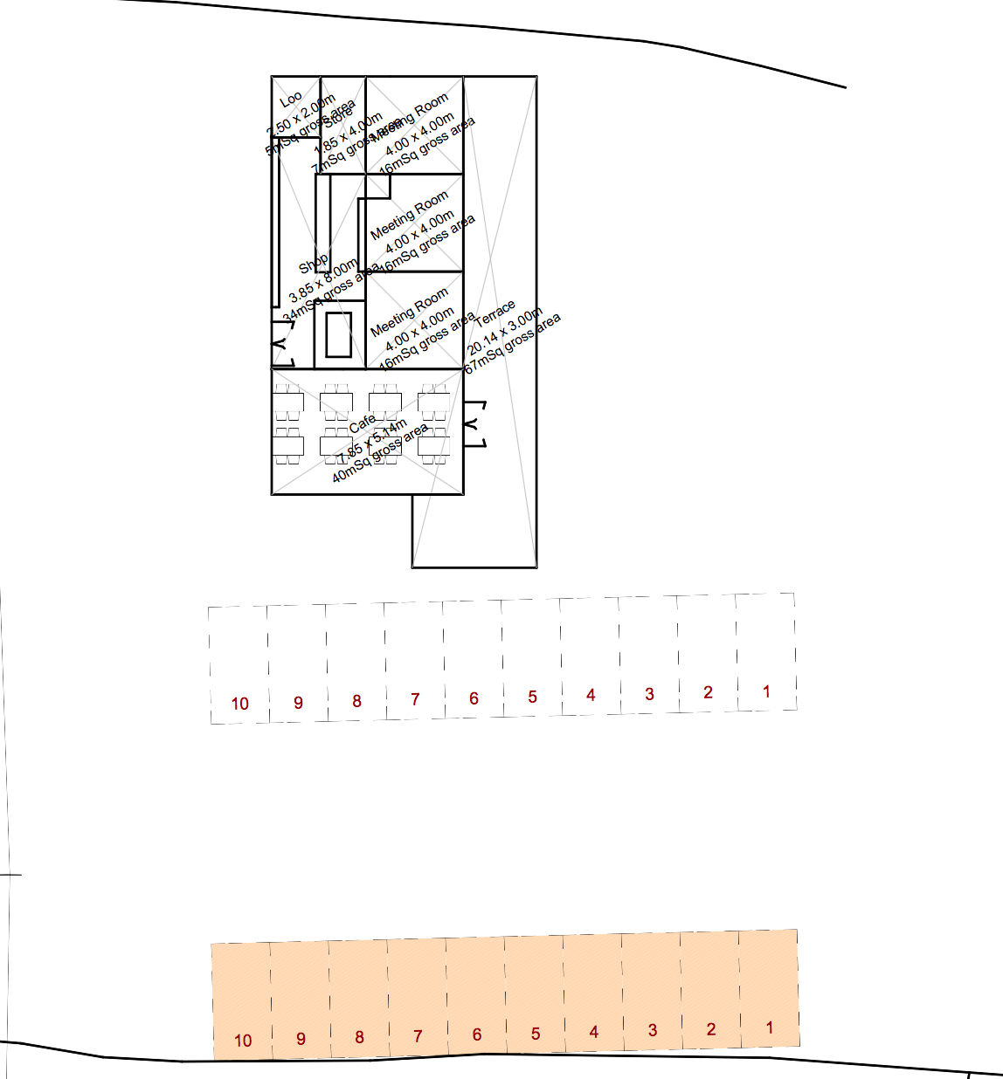
???
Any Questions

